Slide 1
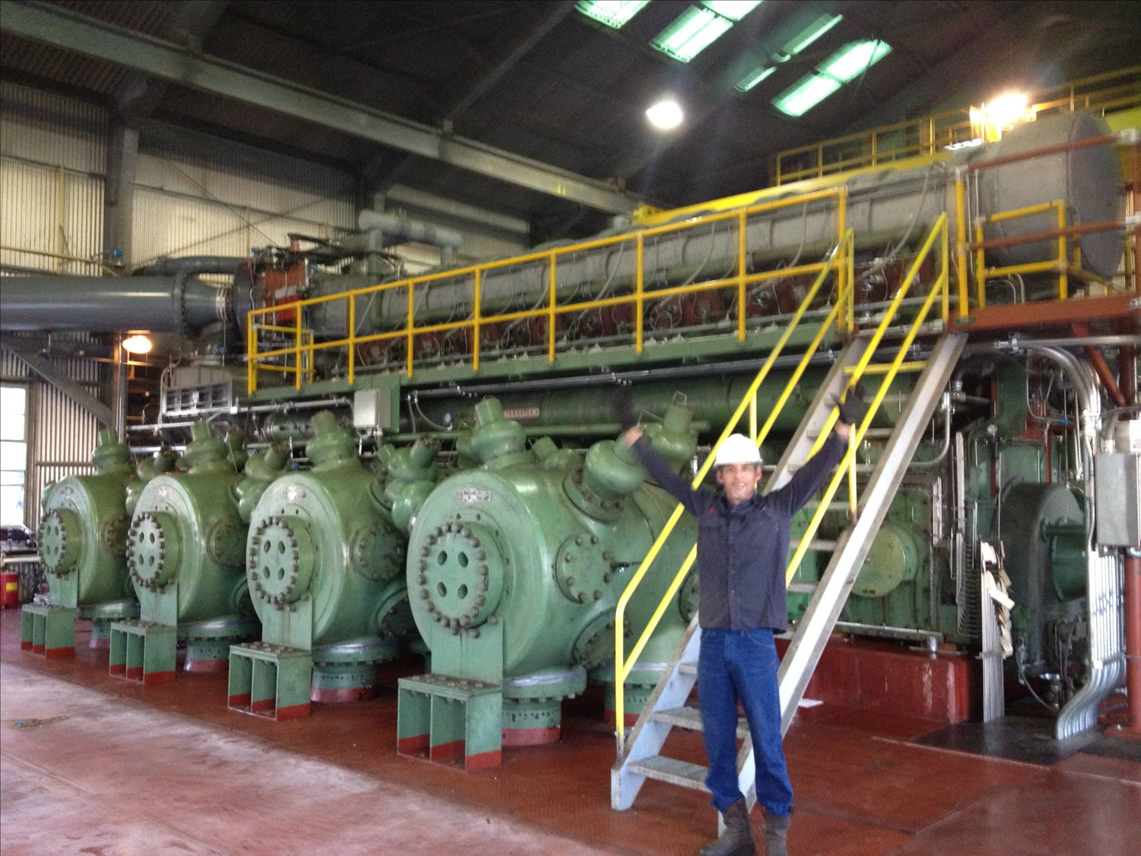
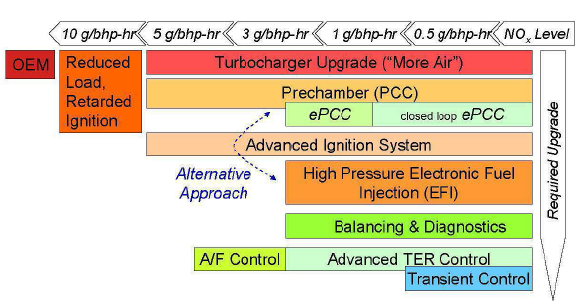
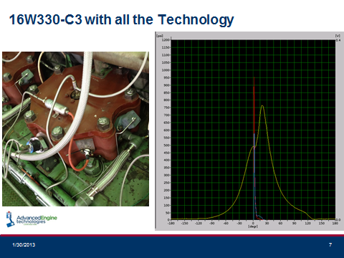
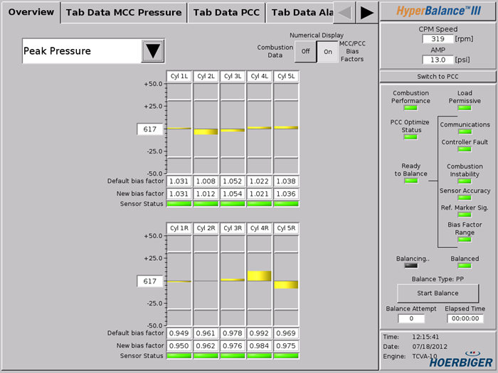
PRCI CPS-1 Program
Emissions Control for Legacy Reciprocating Engines
Goals: Identify cost effective modifications to older integral engines to reduce nitrous oxide (NO_{x}) rather than replace the engines and validate the performance improvements to confirm continued operation.
Key outcomes: Technologies were developed that were 1/6 to 1/3 the replacement cost of the engines.
Improved combustion stability – lower stresses on the engine
Lower fuel consumption than replacement engines
Conclusions: The work produced cost effective solutions that have:
Significantly lower capital requirements to reduce NO_{x} emissions
Better fuel consumption – produces less CO₂ emissions
Wider operating range
Better reliability

